Slide 1
NID Uttar Pradesh District 3100 –District 1570 Albertine Perre-Bulder
Notes:
Good evening everybody,
I would like to extend a special welcome to Pres. and Mrs. Banerjee here in Hilversum.I hope you are enjoying your visit, although I realize that you have a very busy schedule

Slide 3
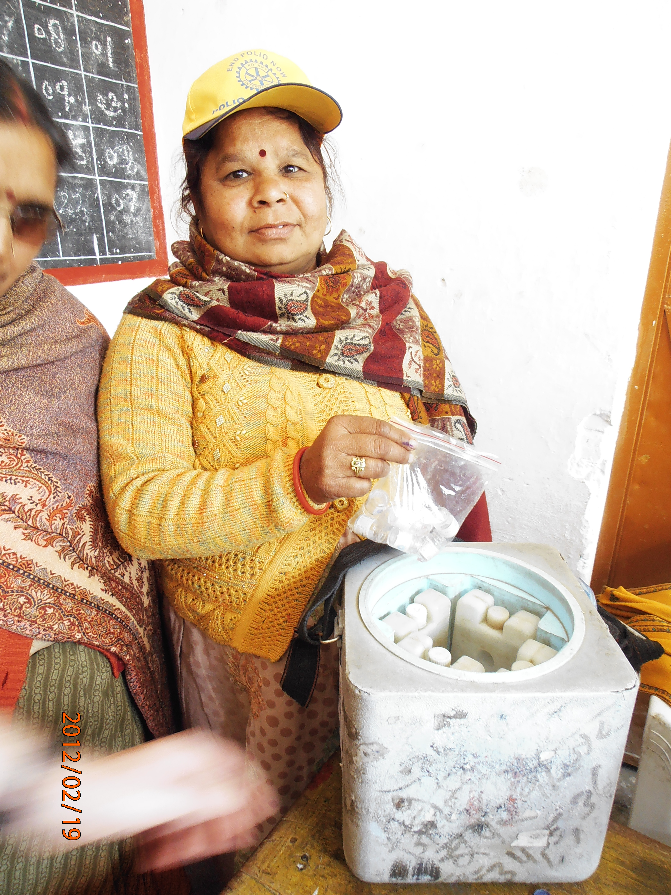
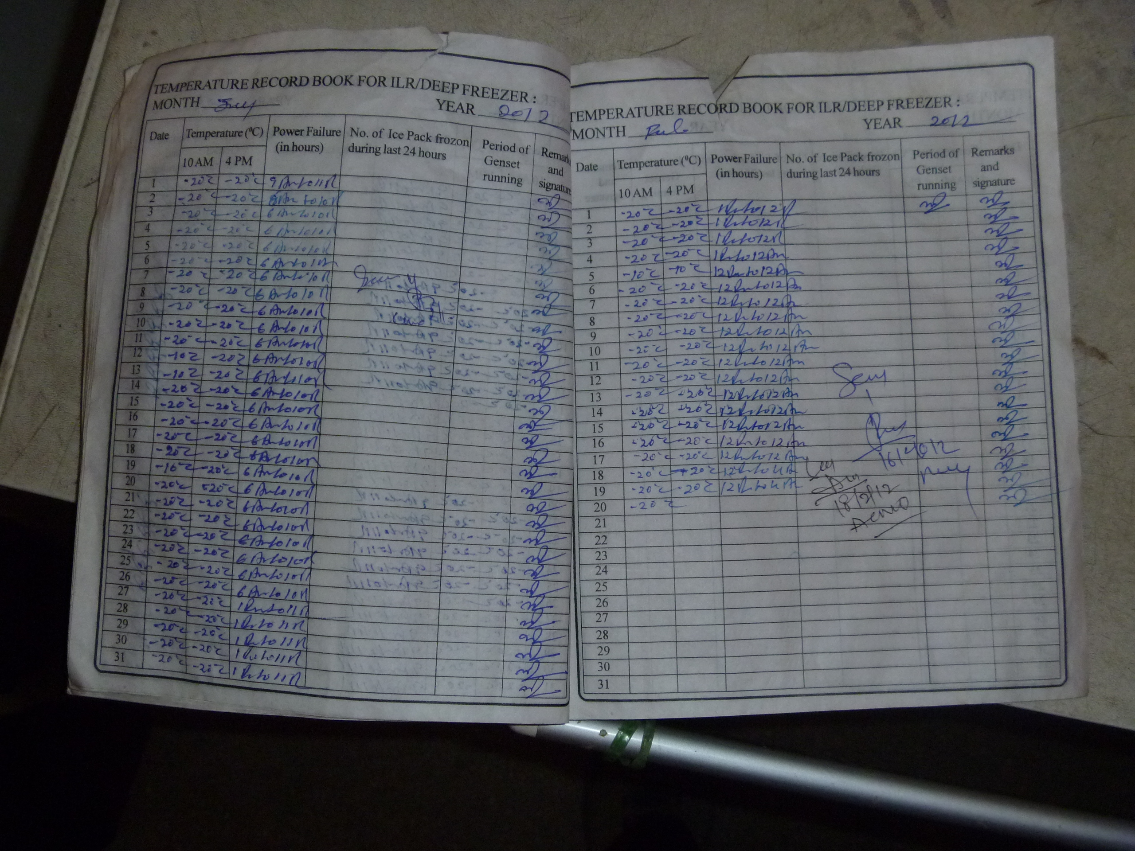
Cold Chain: temperature vaccin

Slide 4
All children are vaccinated in this house

Slide 5
Left pinky nail marked purple

Slide 7
Wheelchair Project Moradabad

Slide 8
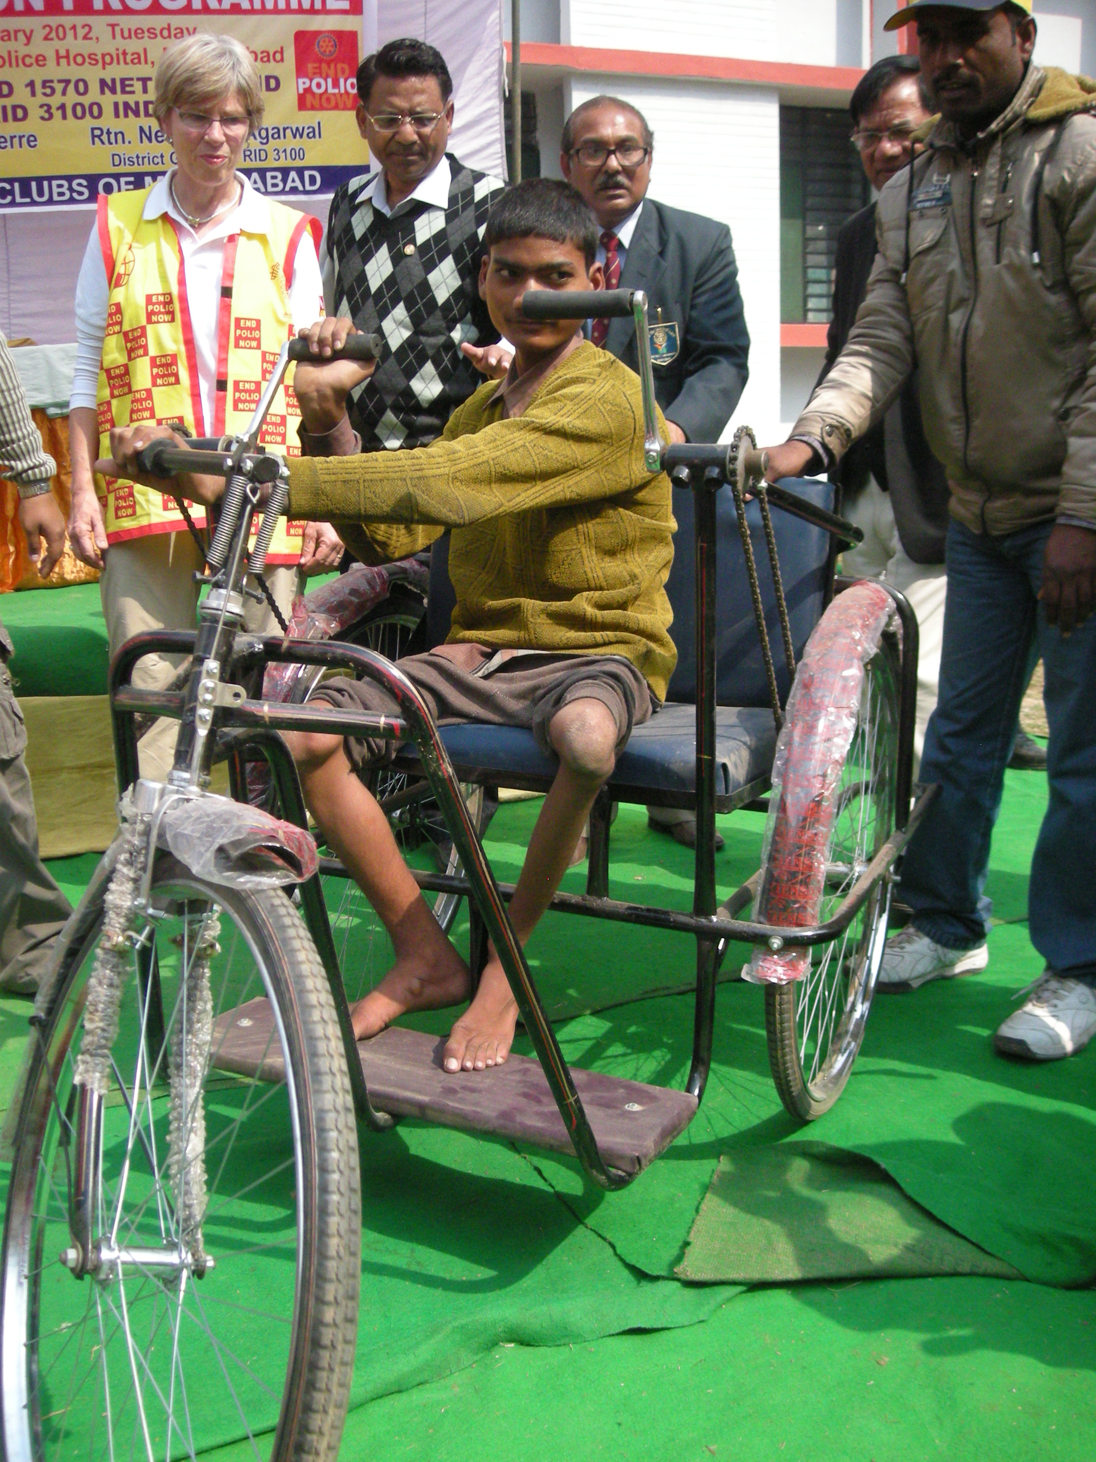

Slide 11
february 2014

Slide 12
february 2014

