Slide 1
Investing in the Future: The Impact of Rotary Youth Exchange
Why Supporting the Long-Term Rotary Exchange Program Matters
Michelle Kovacs
Former Rotary Exchange Student – 1990
Brazil to USA (Ohio – Piqua)

Slide 2
Agenda
My story
Benefits for Exchange Students
Benefits for Host Families
Benefits for Schools
The Long-Term Impact
Call to Action

Slide 3
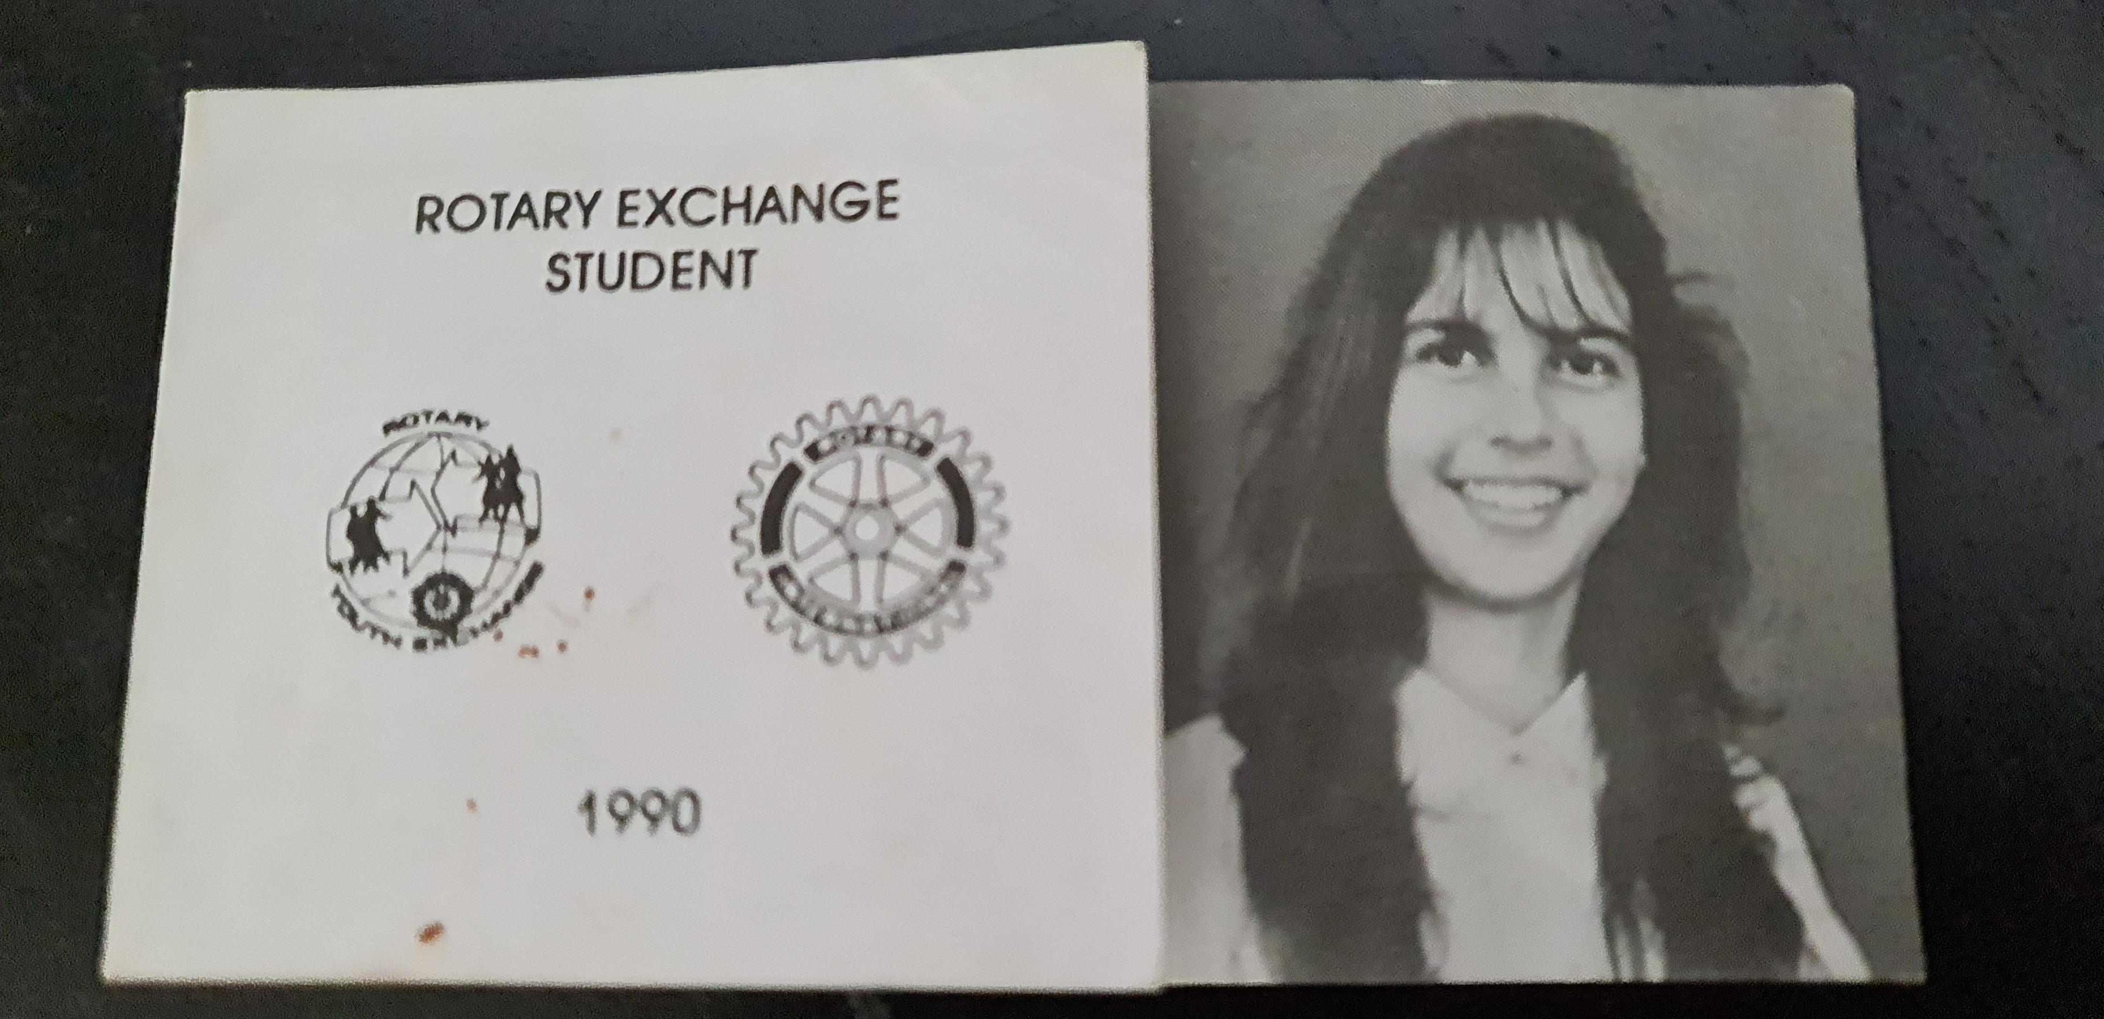
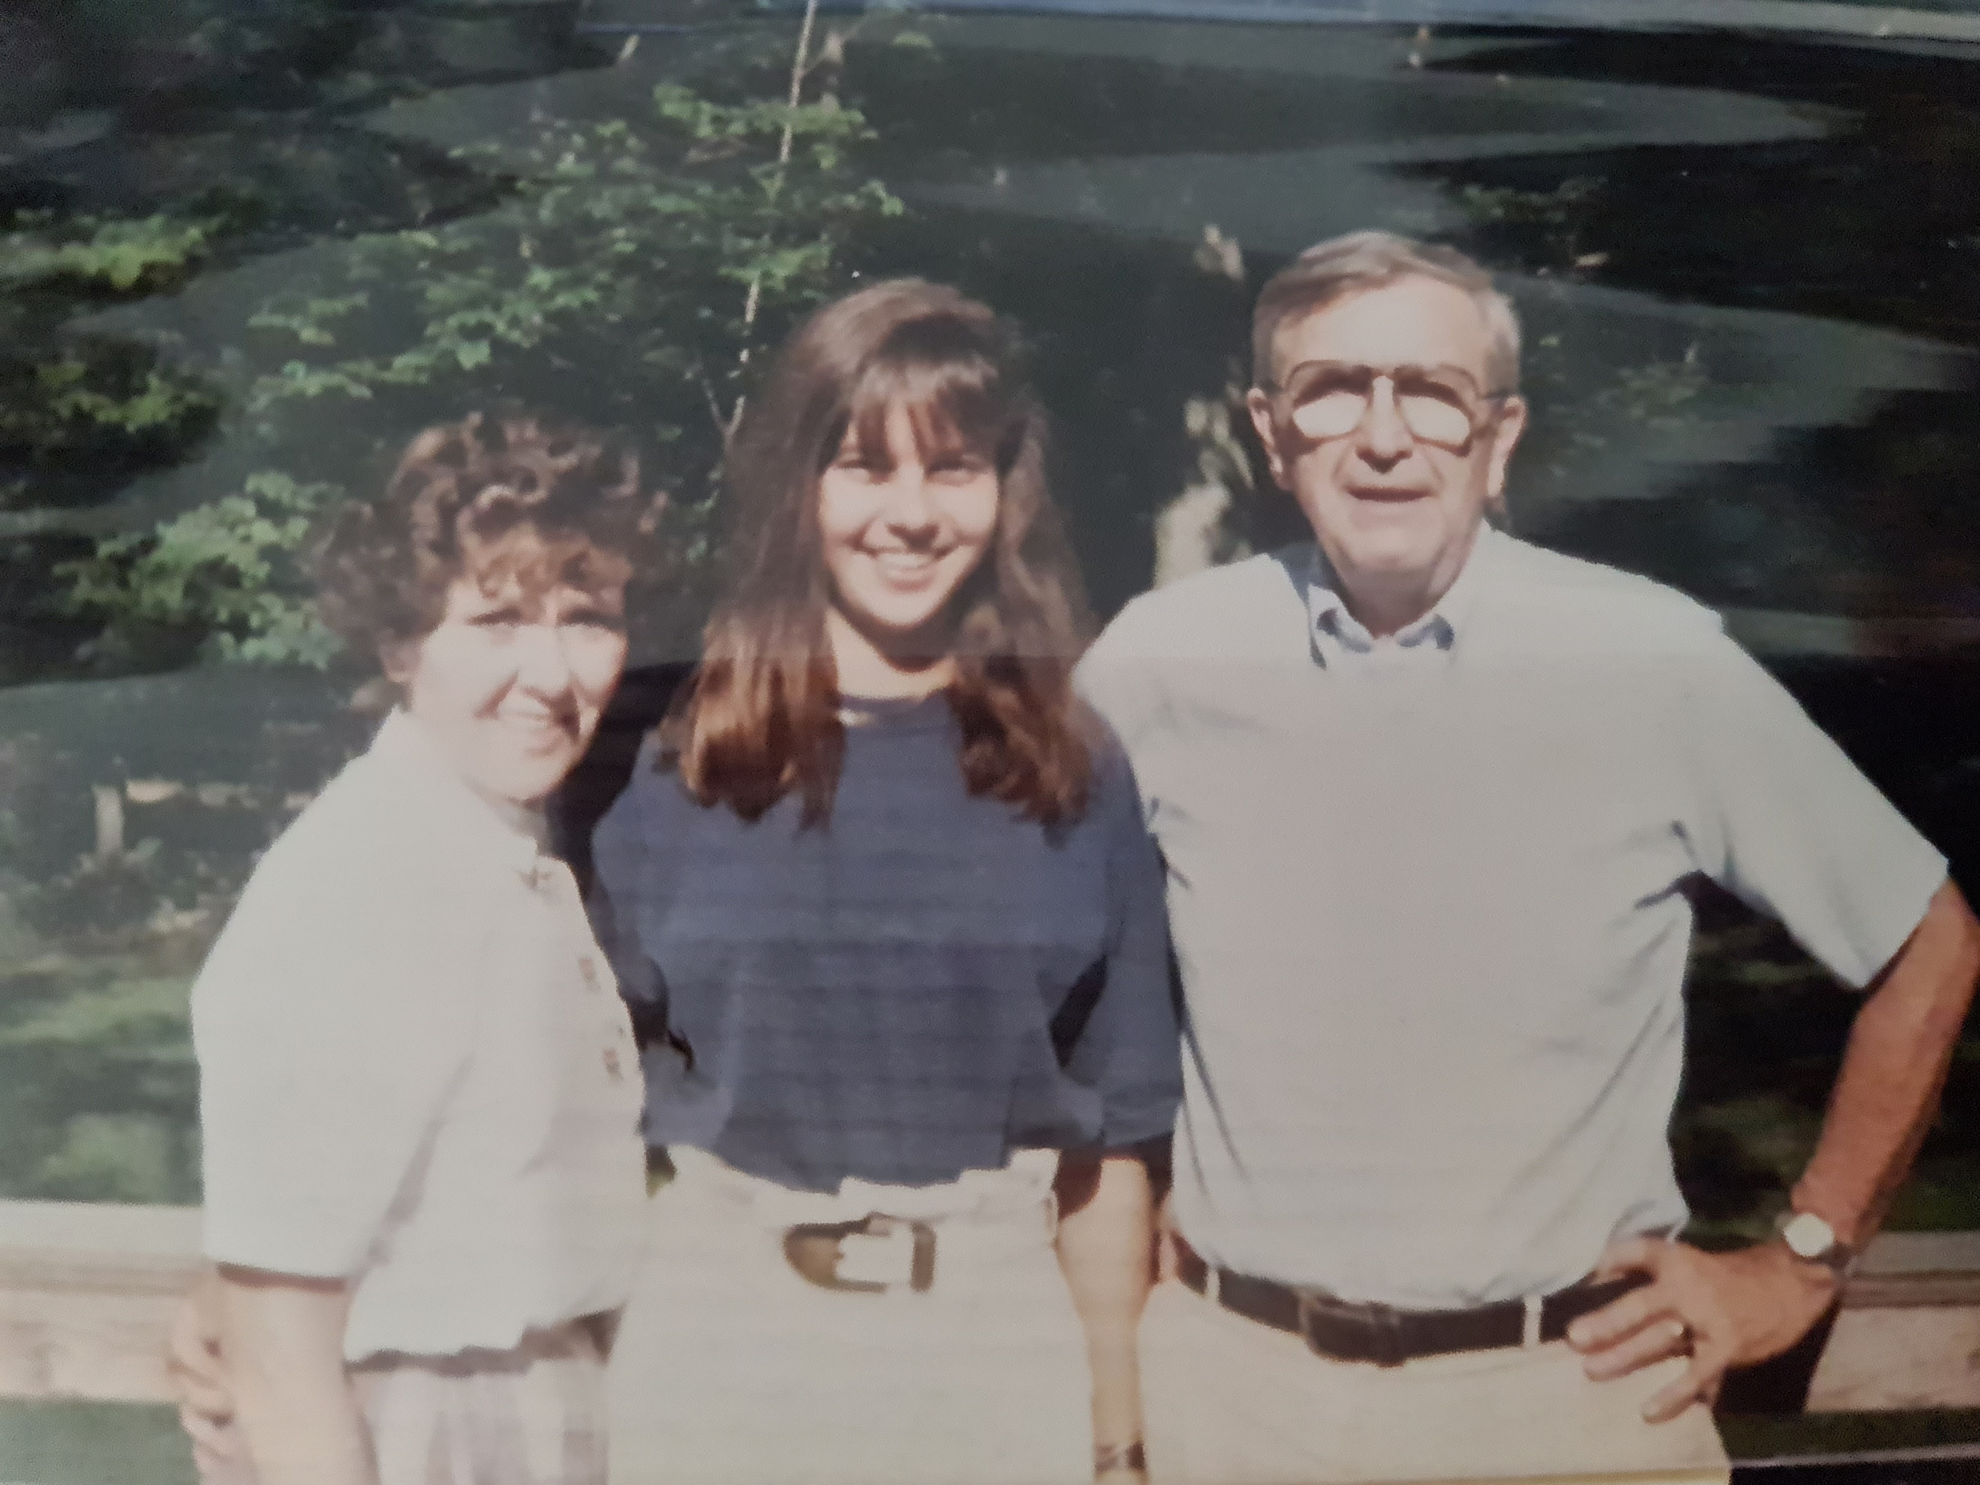
My Story
Who I am
A Rotary family
1990: My Rotary Exchange Experience in Ohio /
Rotary District 6670
3 families
How this program changed my life (and my family)

Slide 4
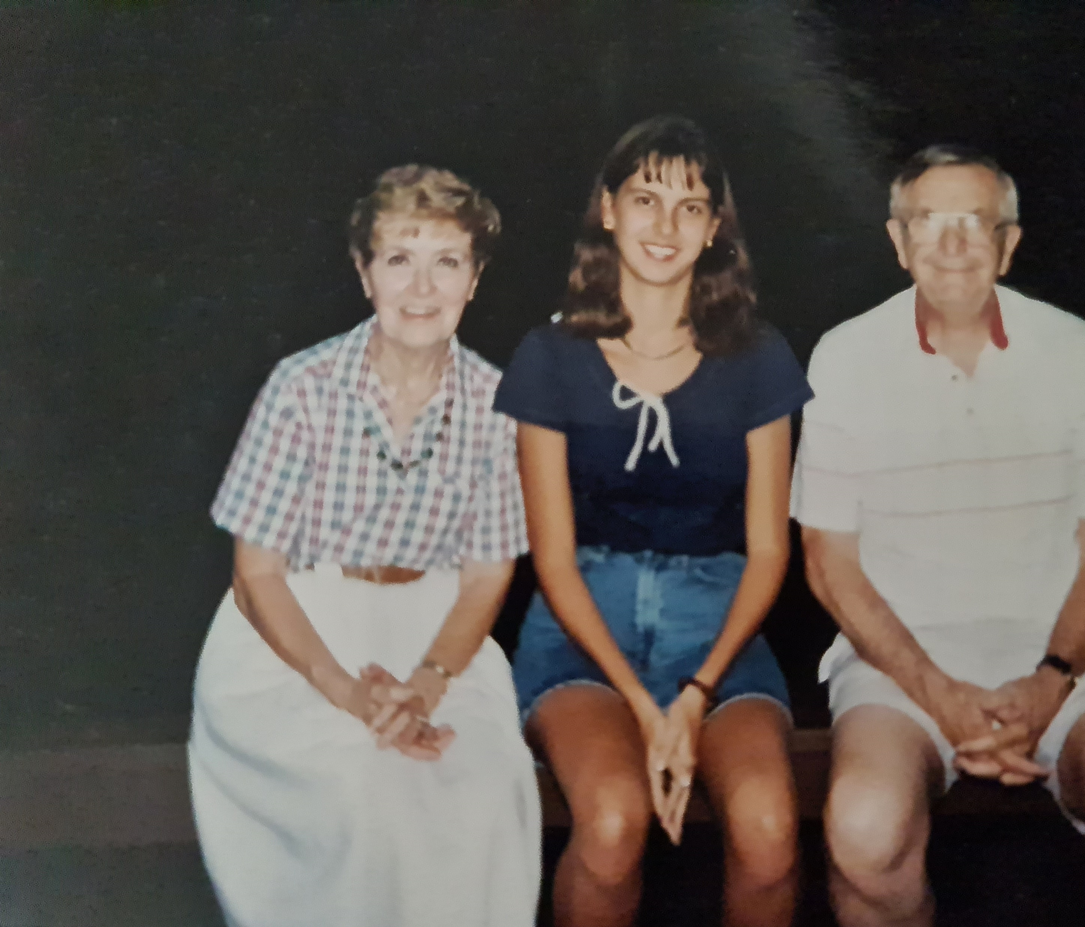
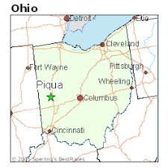
Benefits for Exchange Students
Exposure to new cultures and languages
Personal growth and resilience
Development and life lasting bonds (Doris/mom)
Global citizens

Slide 5
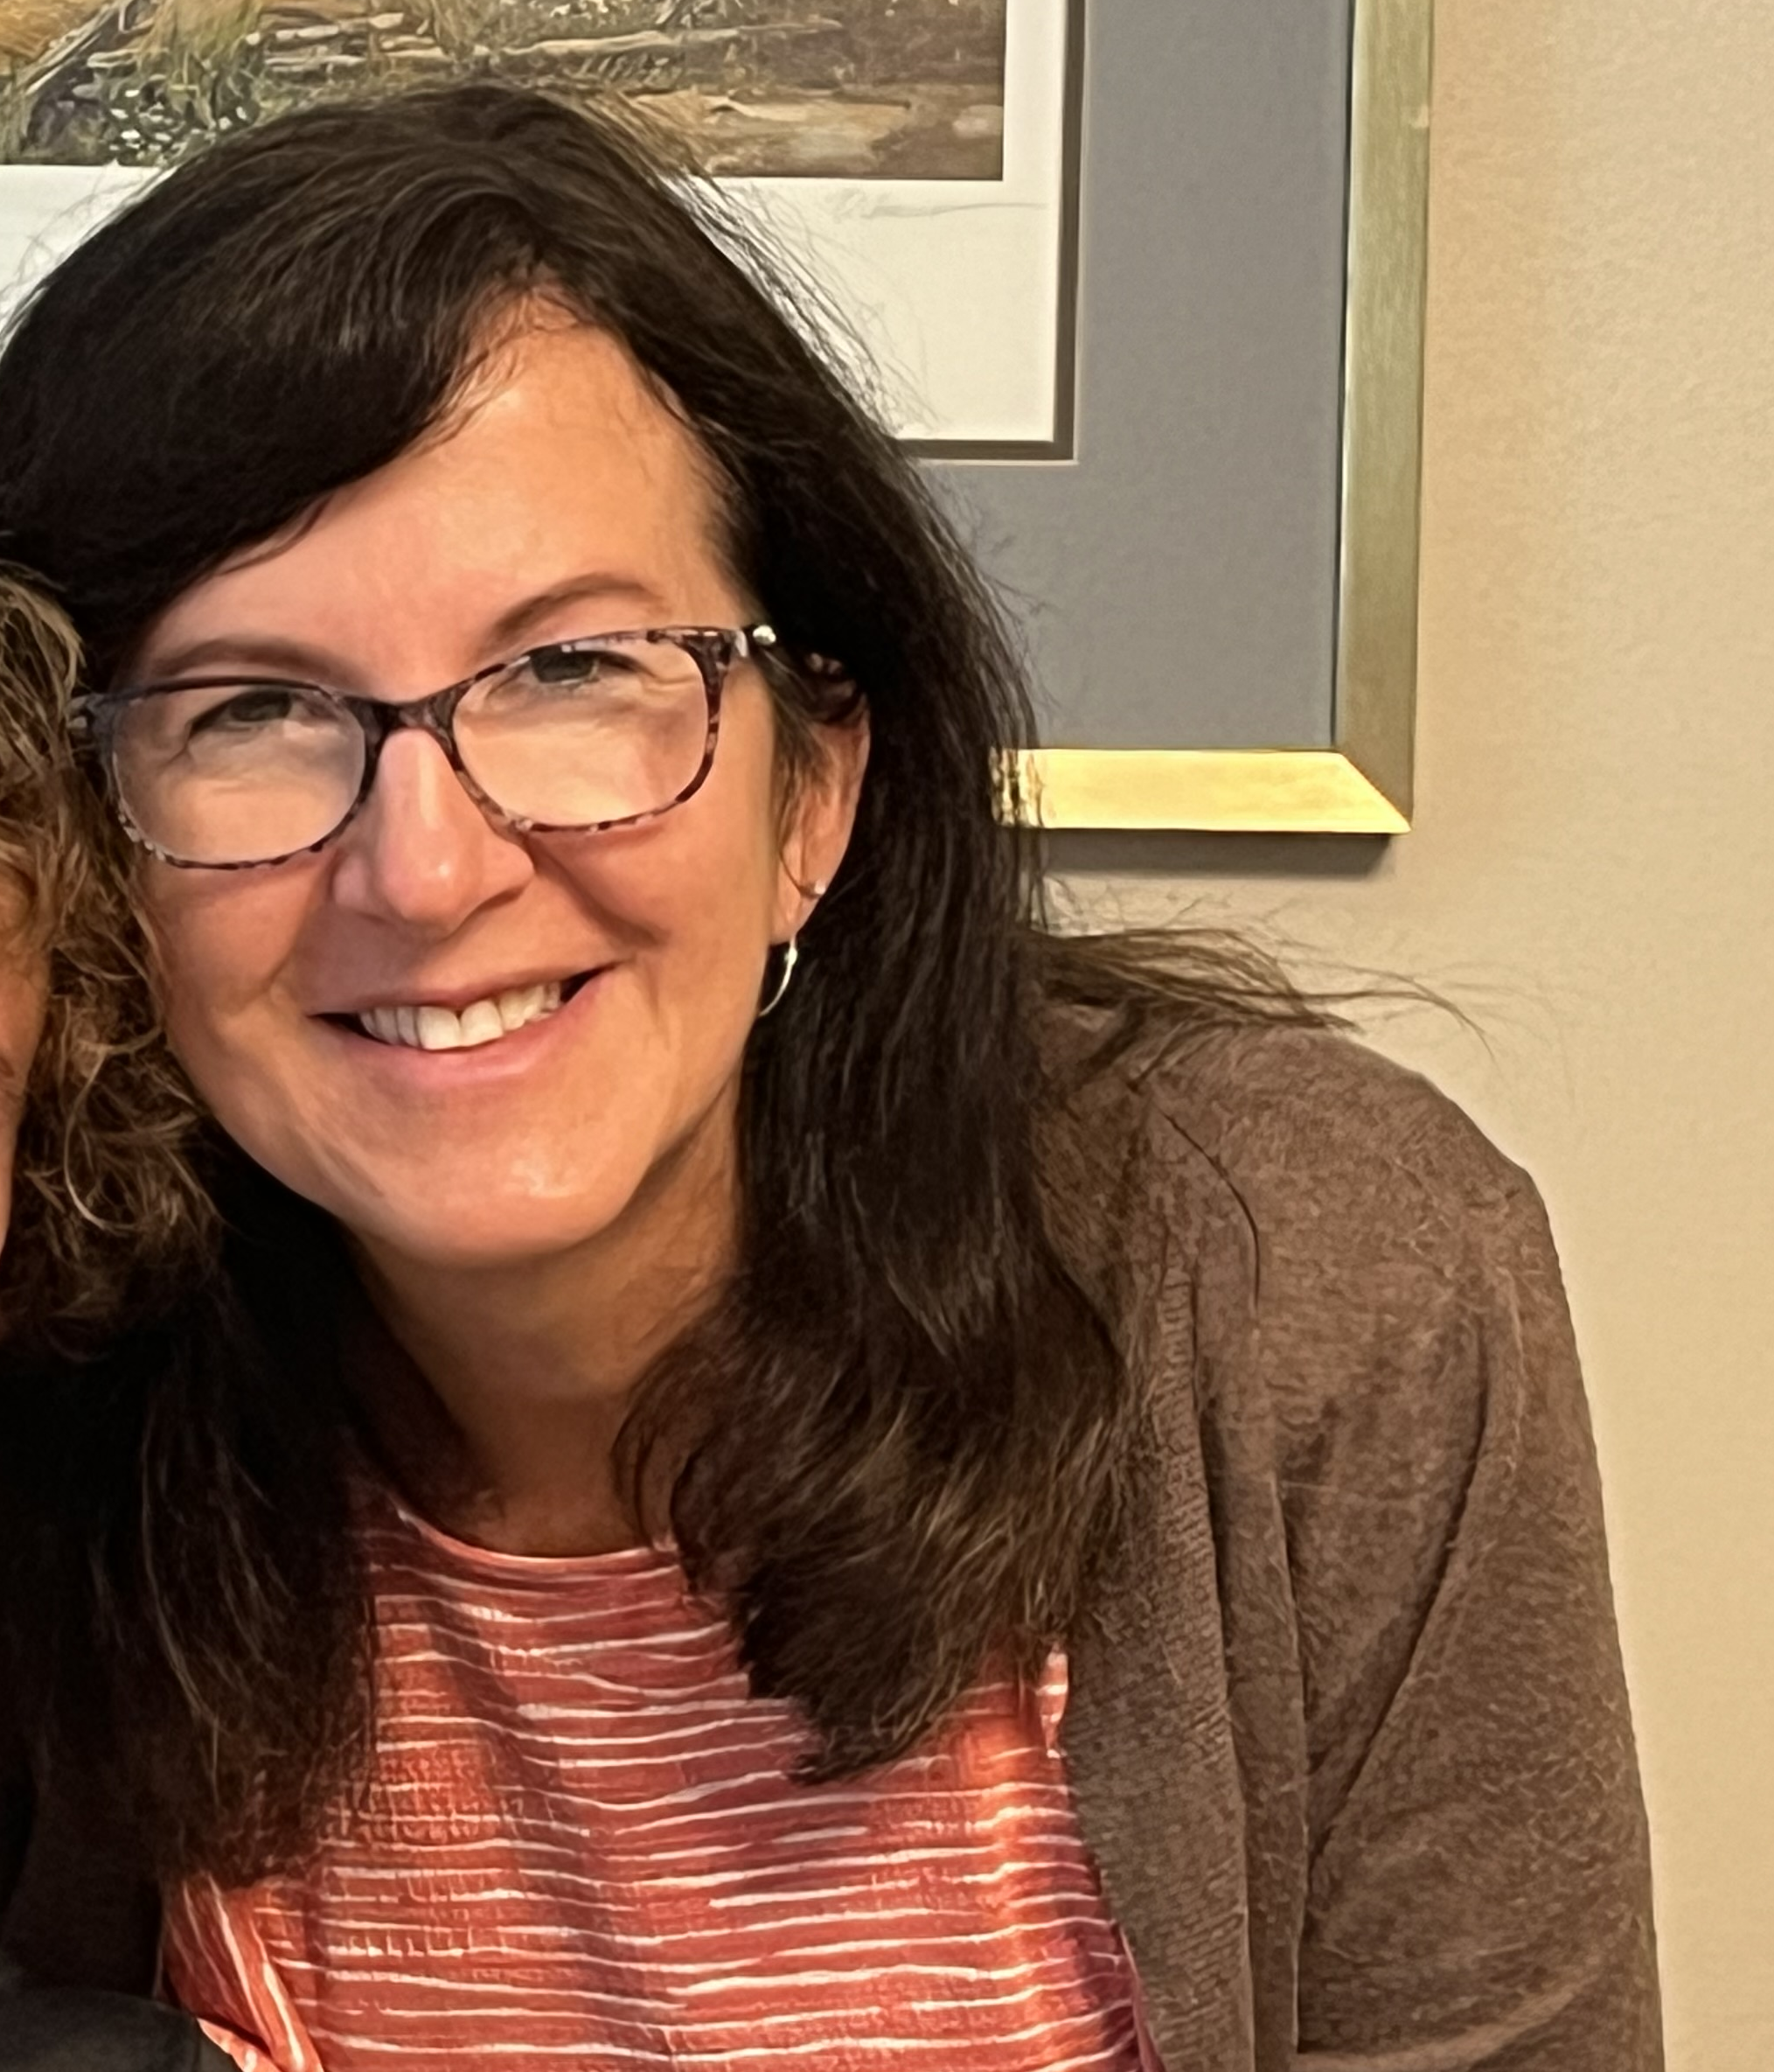
Benefits for Host Families
Cultural exchange at home
Building lasting international relationships
Opportunity to learn and grow through new perspectives
(letter from my host Dad/Tim)
We received 6 Exchange students in our home

Slide 6
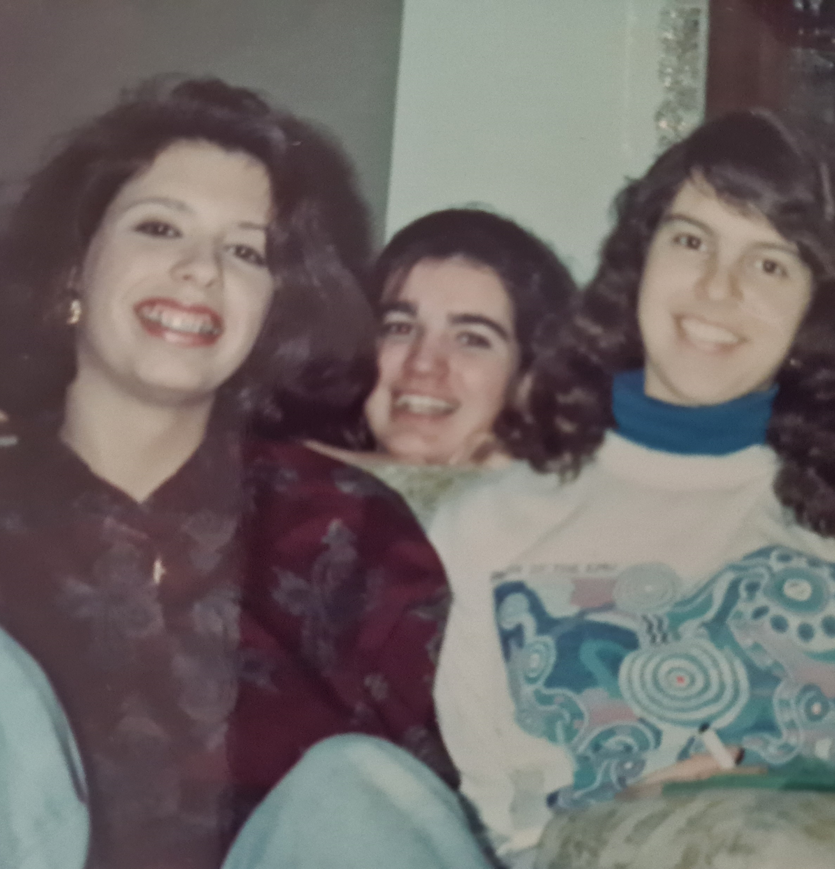
Benefits for Schools
Enhances global awareness among students
Promotes diversity and intercultural dialogue
Fosters an environment of inclusivity and learning (several formal presentations about my own country, breaking stereotypes, example to other students)
Two exchange students: Mencia (already accepted) ☺

Slide 7
The Long-Term Impact
Strengthening international cooperation
Rotary’s role in shaping future global citizens
How cultural exchange fosters peace and understanding

Slide 8
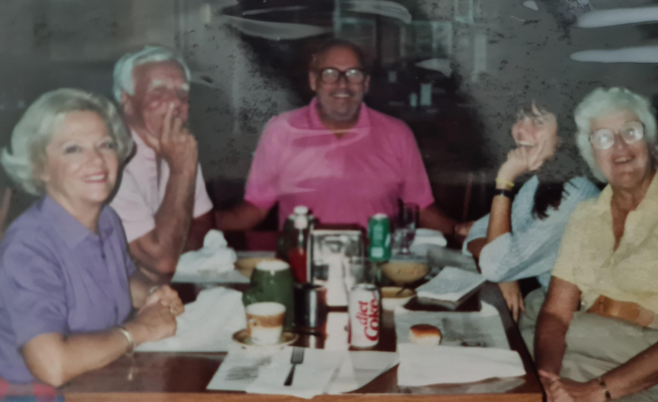
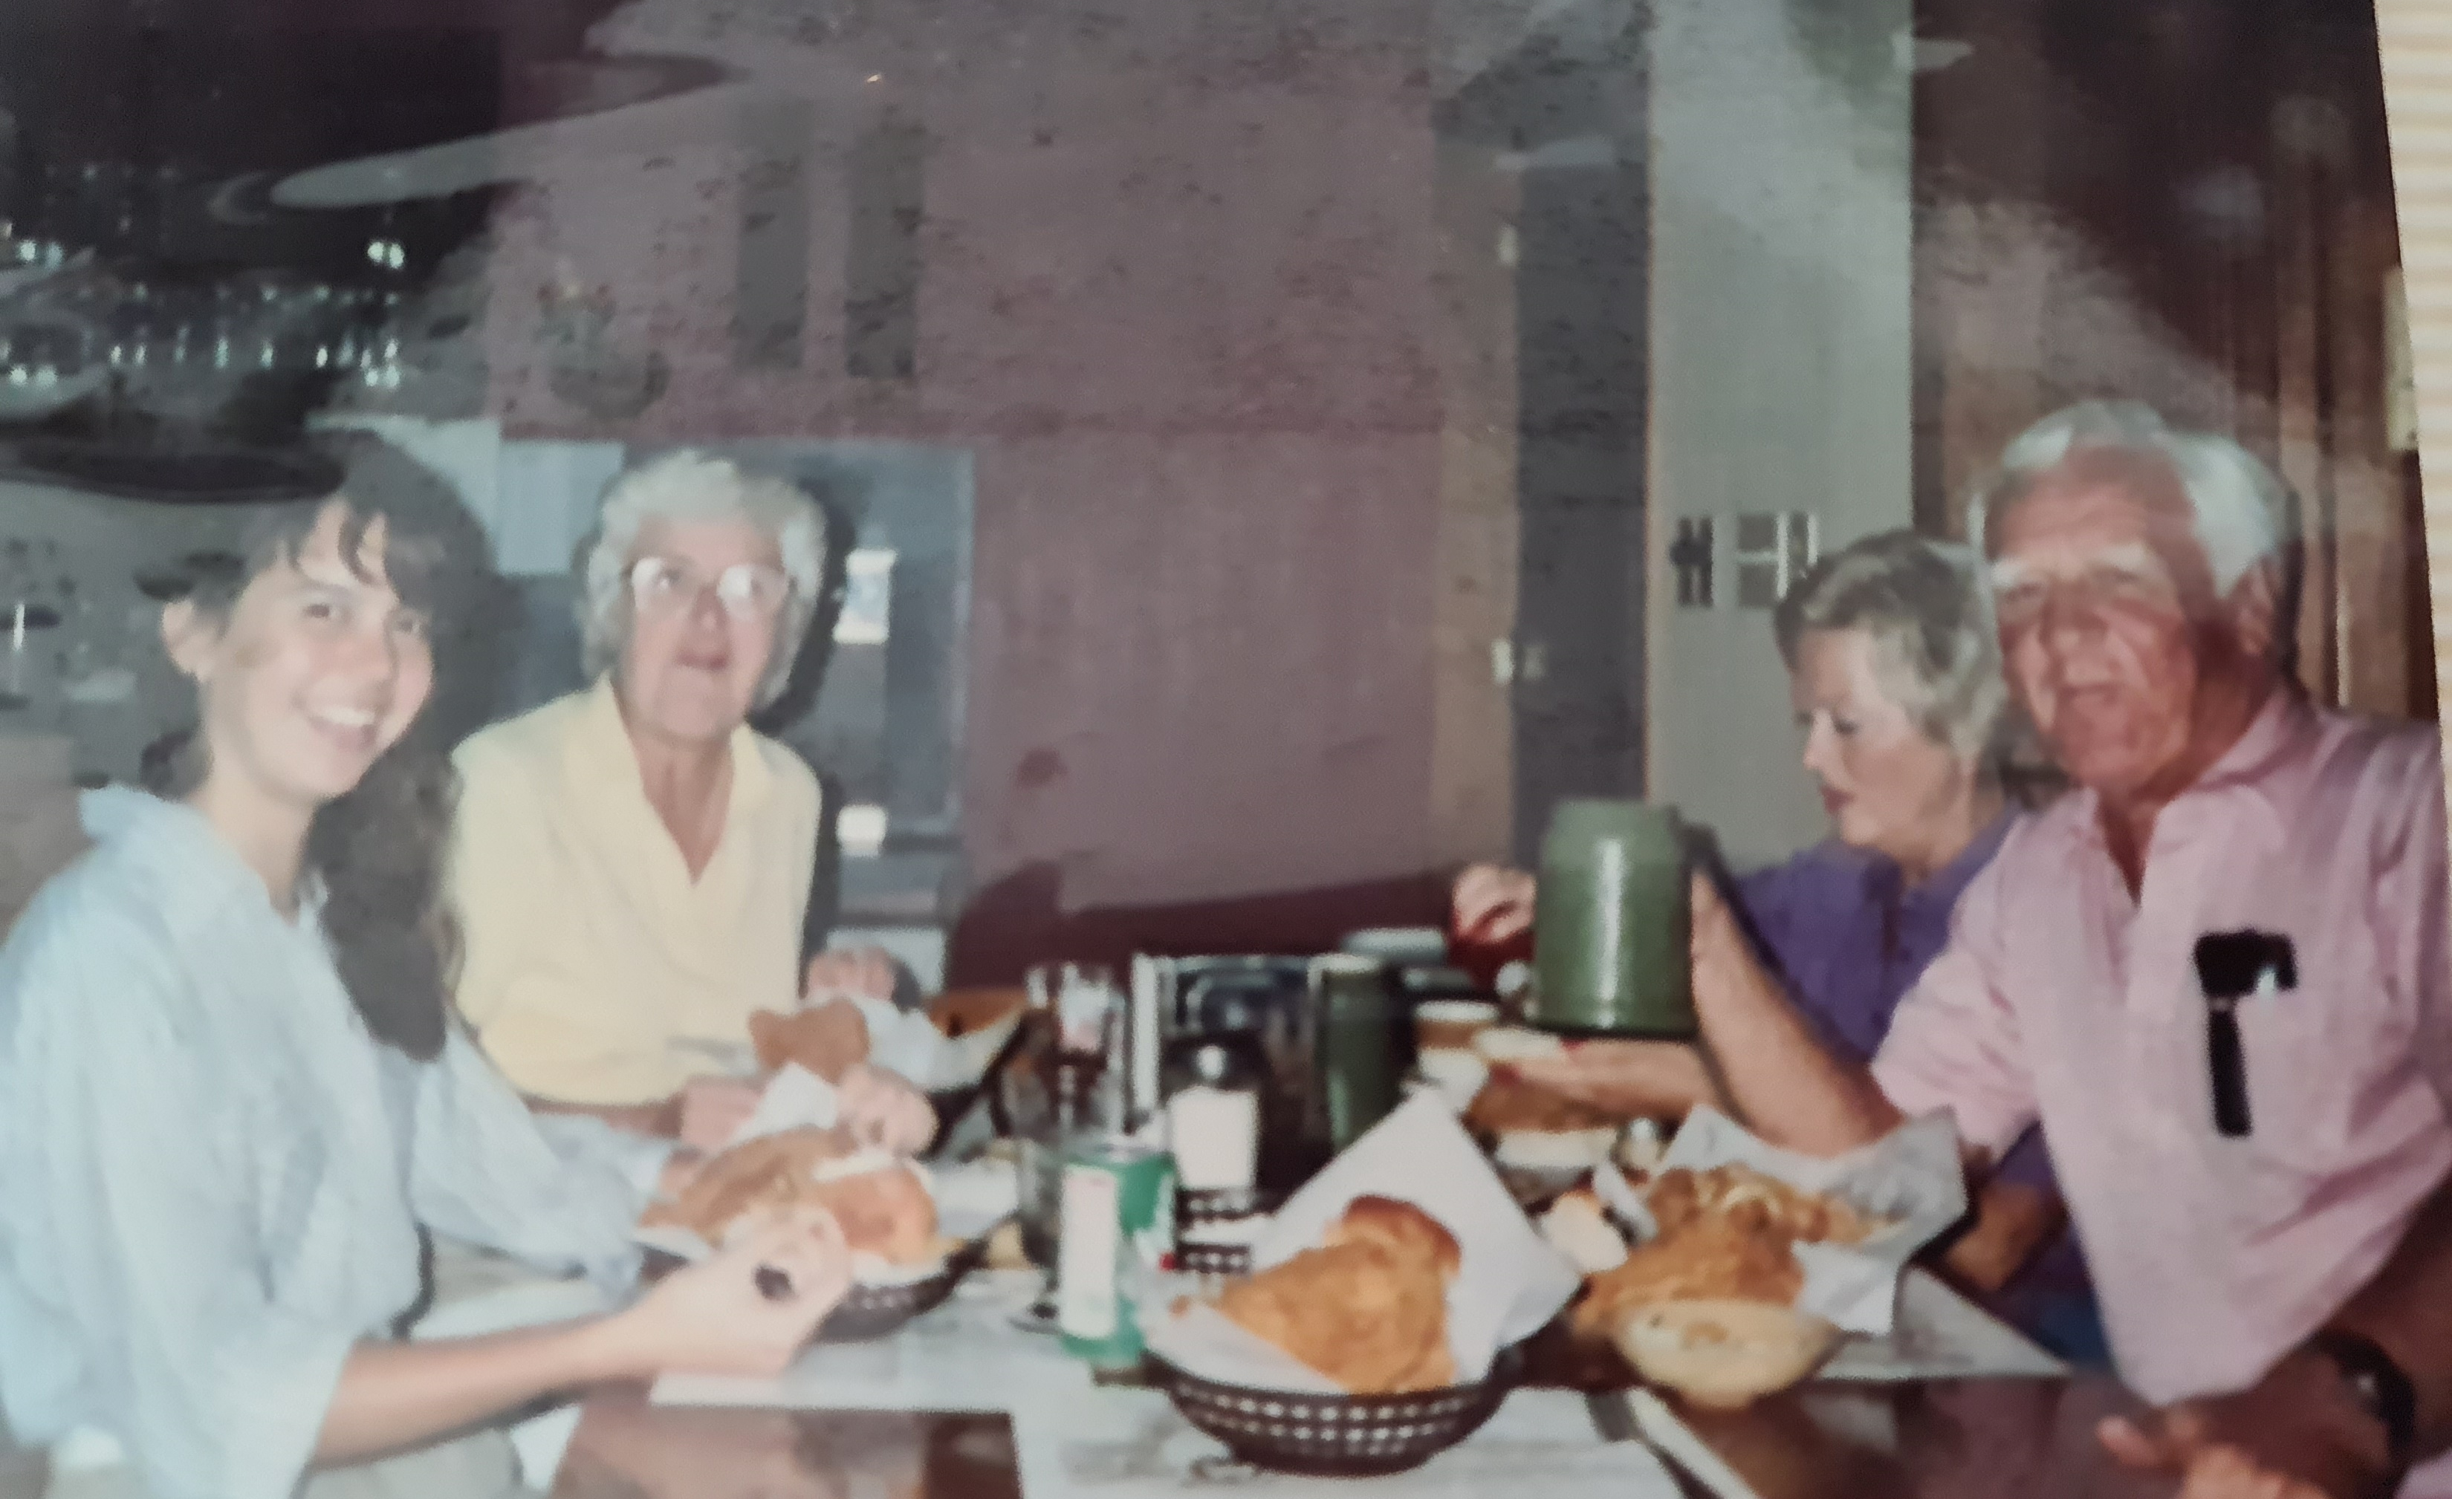
7 Call to action
Call for Action
Thank you for believing in the Rotary Youth Exchange Program – receiving your First Rotary Exchange Student in 2025! ☺
Engage rotary families in hosting and supporting exchange students in the following years
Making 2025-2026 a unique experience to the exchange student coming to Gilze Rotary Club

Slide 9
End up message…

Slide 10
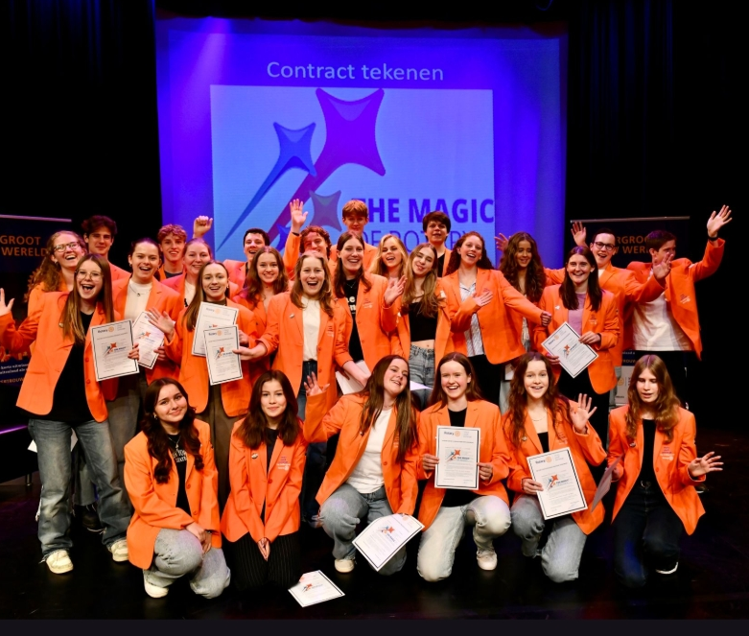
What you do for yourself dies with you, but what you do for others lives on

Slide 11
Thank you!
Questions?

